Slide 1


Spatial Data Analysis
Project submitted By: Naresh Kumar Nagaraj(21250702)
Module: CS621B Spatial Databases

Slide 2
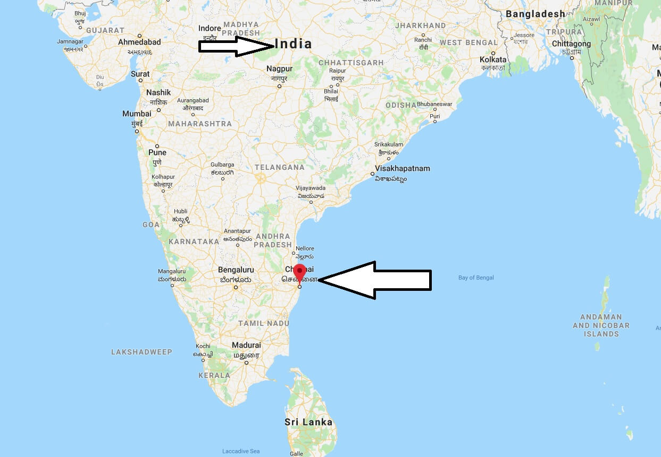
Spatial Analysis of A safer zone to live in Chennai
Chennai, on the Bay of Bengal in eastern India, is the capital of the state of Tamil Nadu.
We will try to find out best zone to live in based on less flooded and rainwater stagnation places when there is heavy rain.

Slide 3
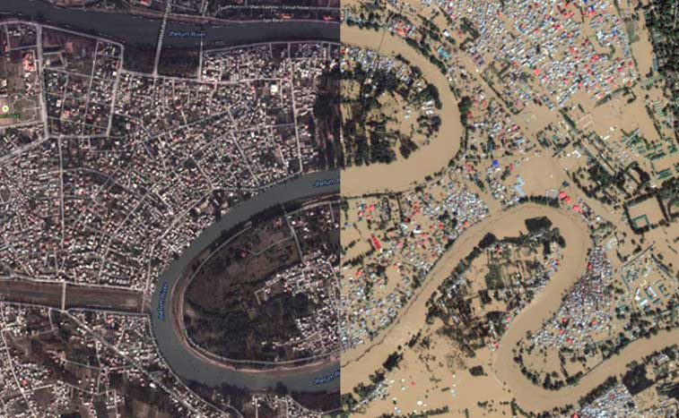
Motivation
The 2015 South India floods resulted from heavy rainfall generated by the annual northeast monsoon in November–December 2015. More than 500 people were dead and over 1.8 million people were displaced.
The flooding in Chennai city was described as the worst in a century.
It has badly affected the lifestyle of people, where many of the houses were flooded in the city.
I wanted to find the safest zone to live across the city by the following conditions:
Zone’s which has less flooding area, apart from default flood-prone areas.
Less impact of rainwater stagnation in the areas and nearby.
To avoid the zones which were mostly affected near the coastline.

Slide 4
Analysis
To aid her search, we will analyze the following.
Visualize the entire dataset on the map.
Analyze the general flood-prone areas.
Comparing the preflood data with flood data.
Analyzing the height of rainwater stagnation across areas.
Selecting the zone for the safer residential area.
Distance to the safest zone from the coastline.

Slide 5
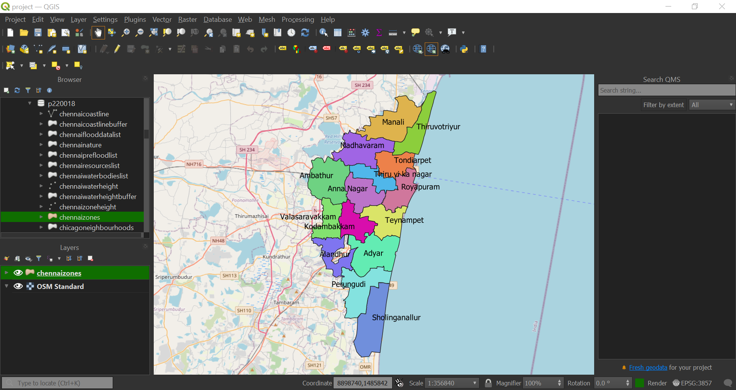
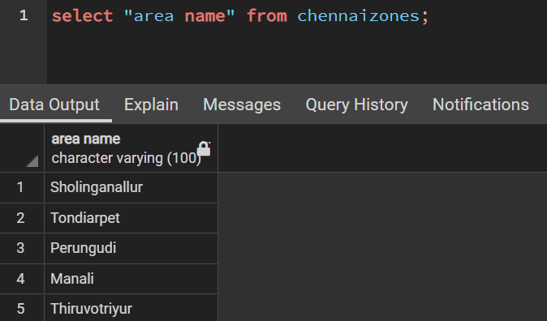
Analysis Visualize all the zones across Chennai on the map.

Slide 6
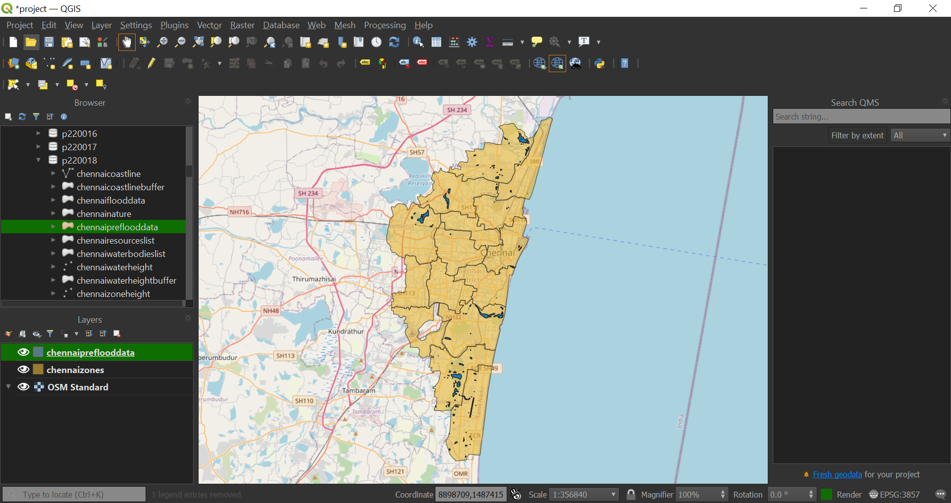
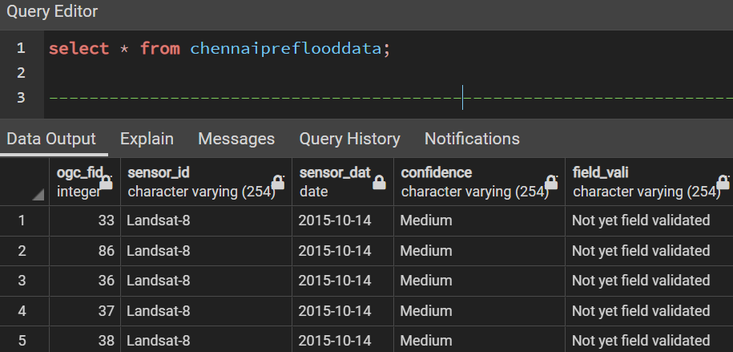
Analysis Visualize all the flood-prone areas across the Chennai Zones

Slide 7
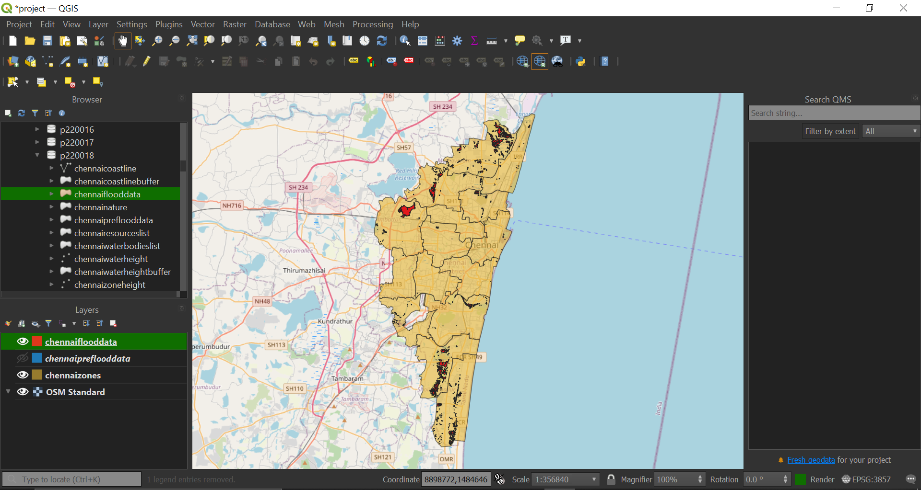
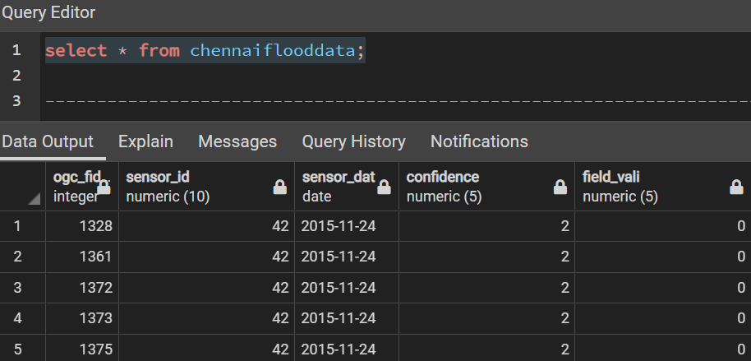
Analysis Visualize all the flood-affected areas across the Chennai Zones

Slide 8
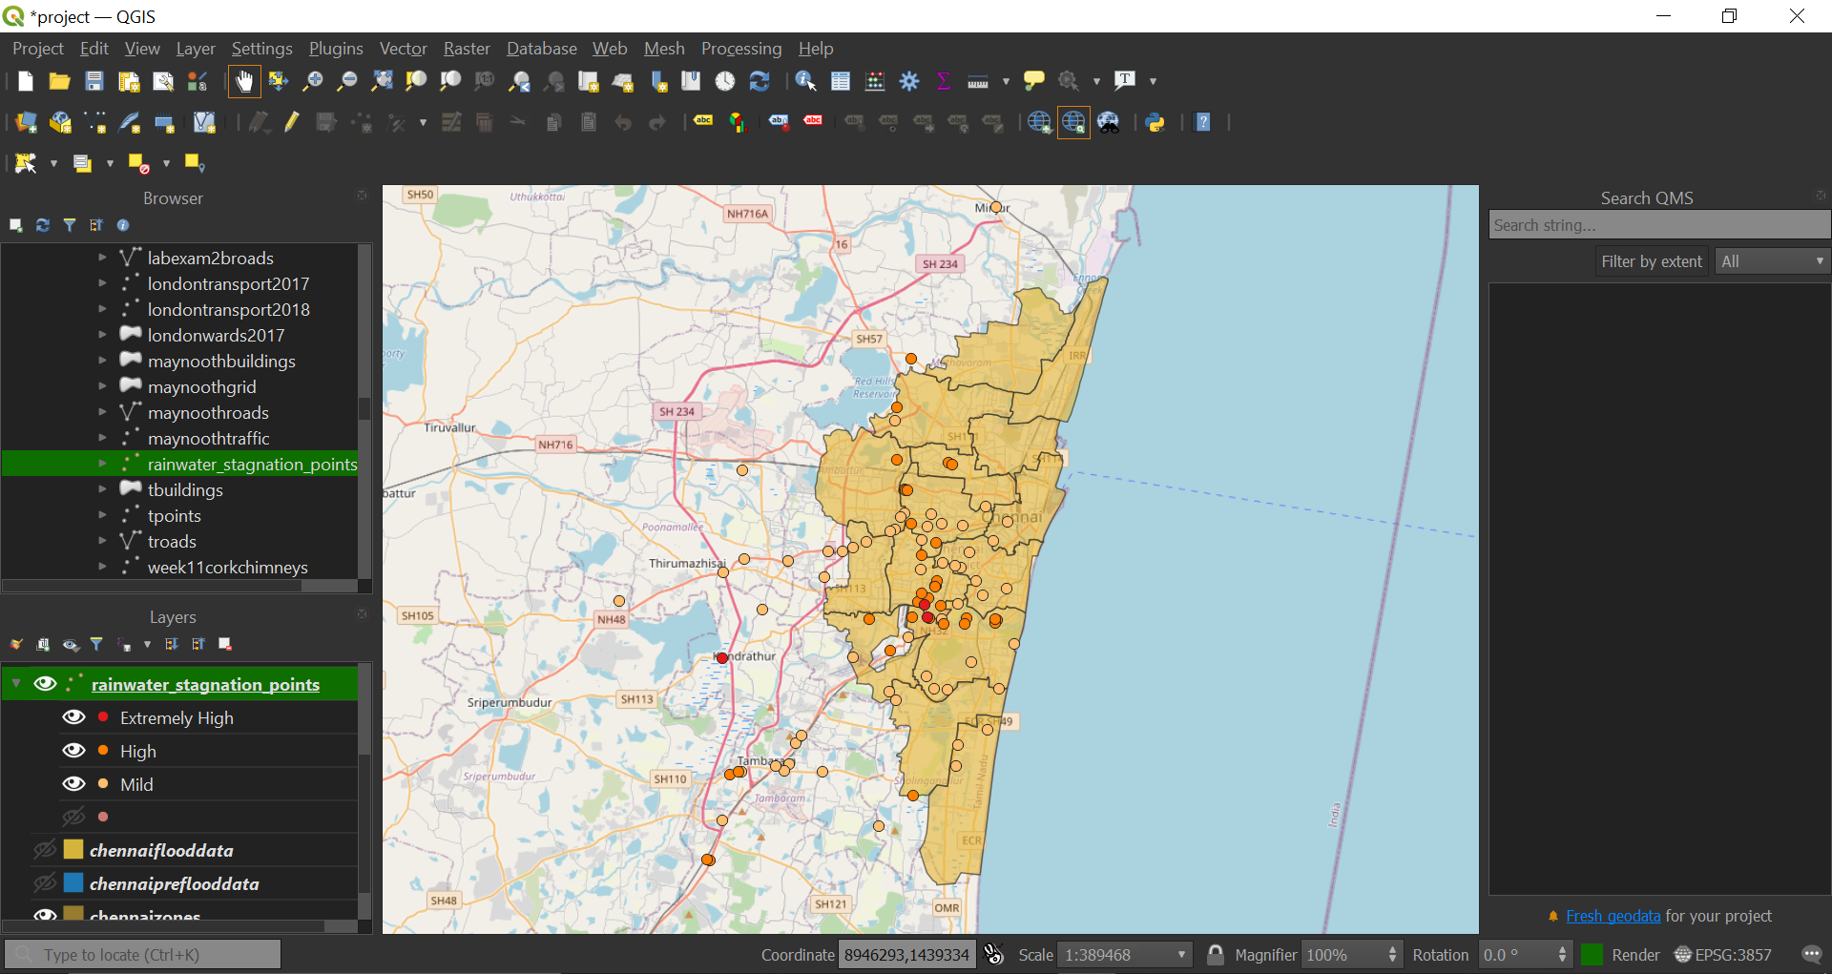
Analysis Visualize all the reported Rainwater stagnation places from our data

Slide 9
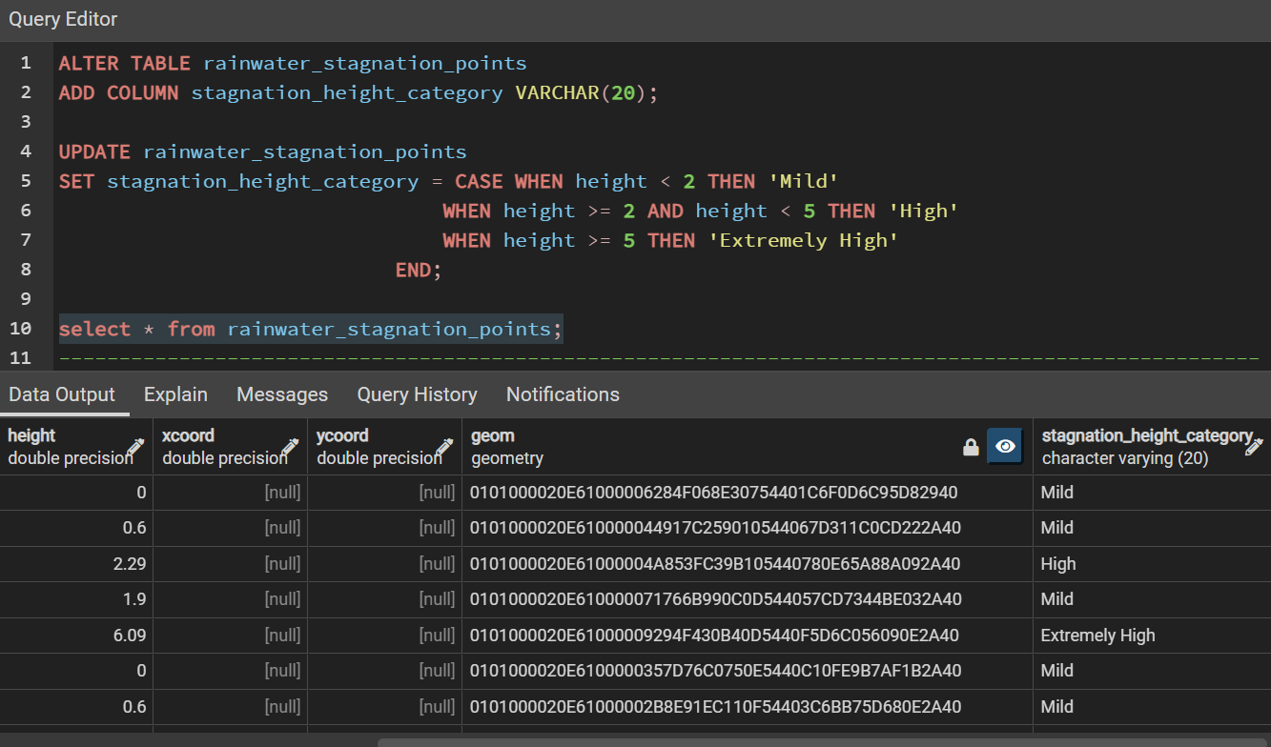
Analysis Analyze the Rainwater stagnation points by the height of water level

Slide 10
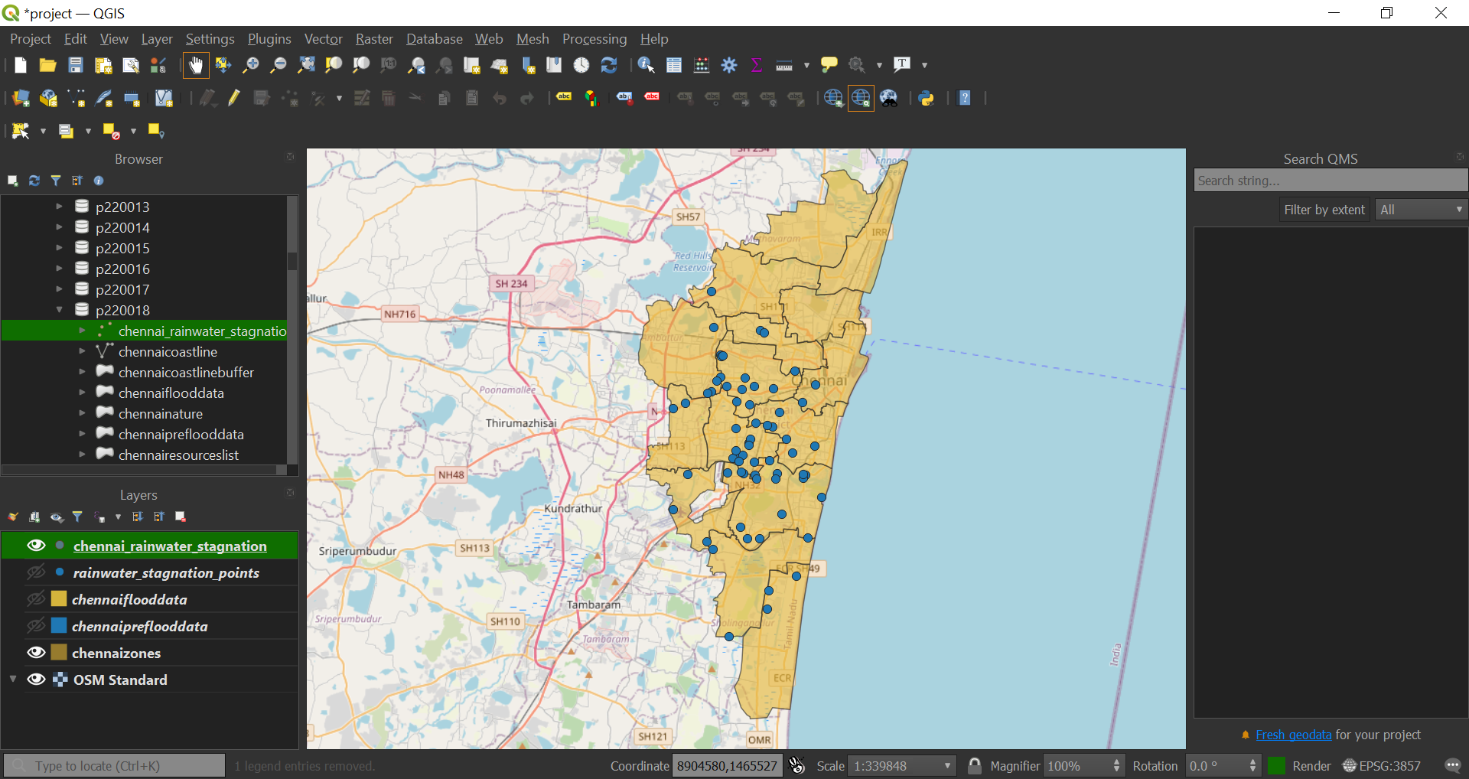
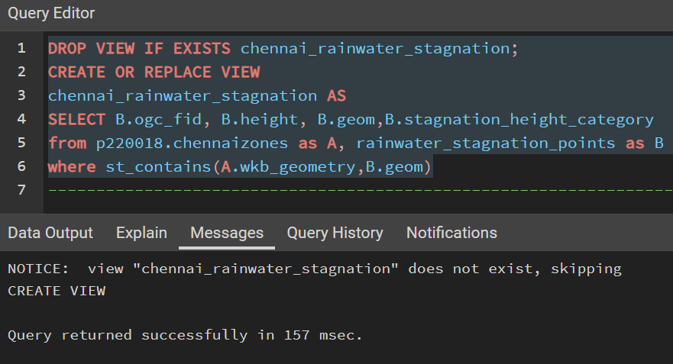
Analysis Visualize all the Rainwater stagnation places inside Chennai Zone’s

Slide 11
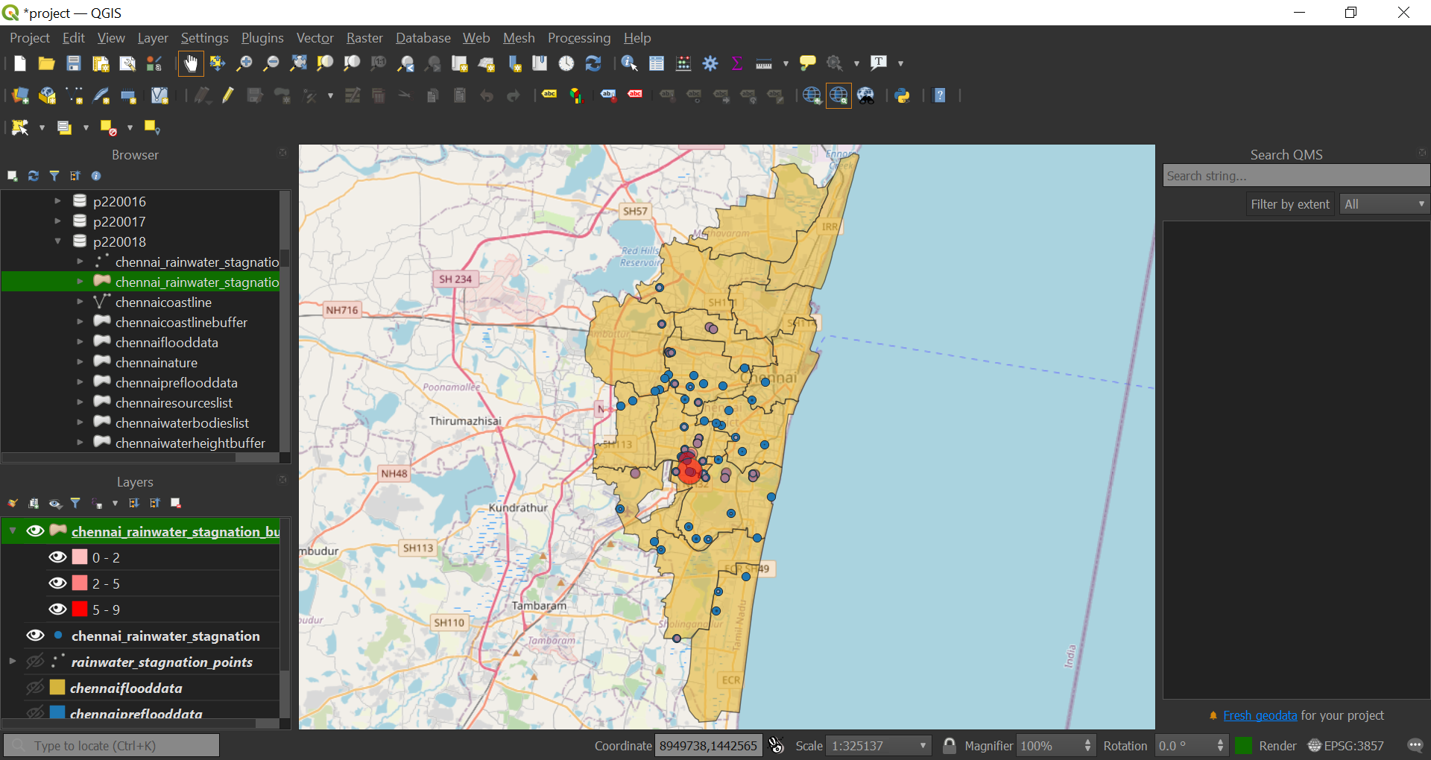
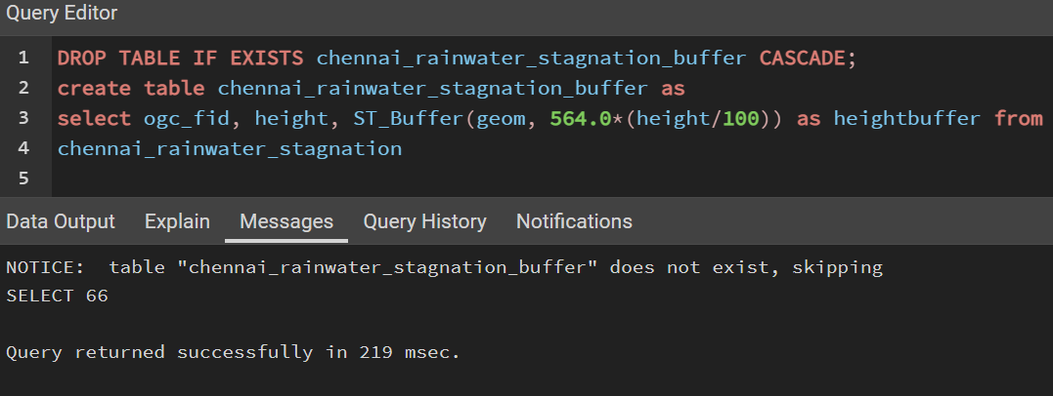
Analysis Creating buffer for the Rainwater stagnation points concerning height

Slide 12
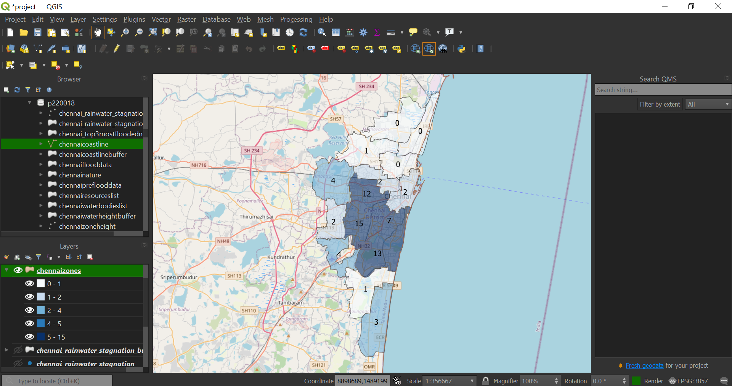
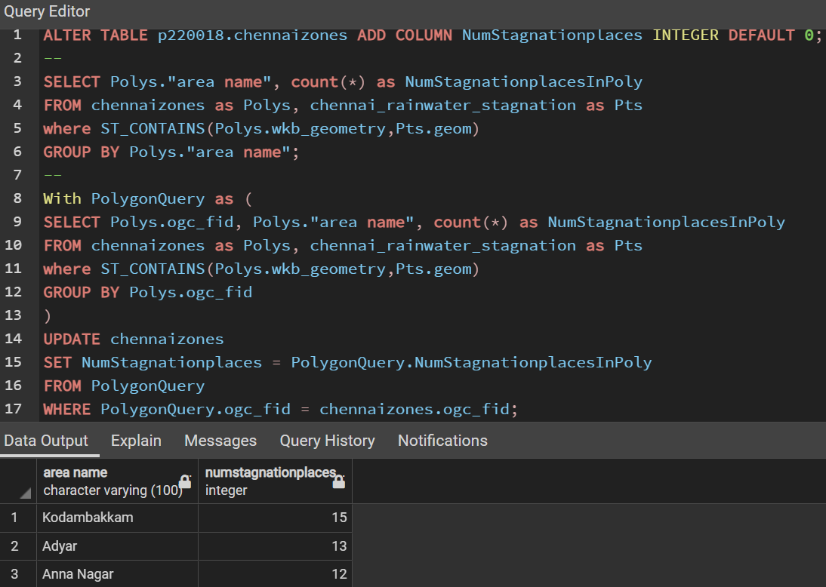
Analysis Choropleth mapping of the total number of Rainwater stagnation areas reported

Slide 13
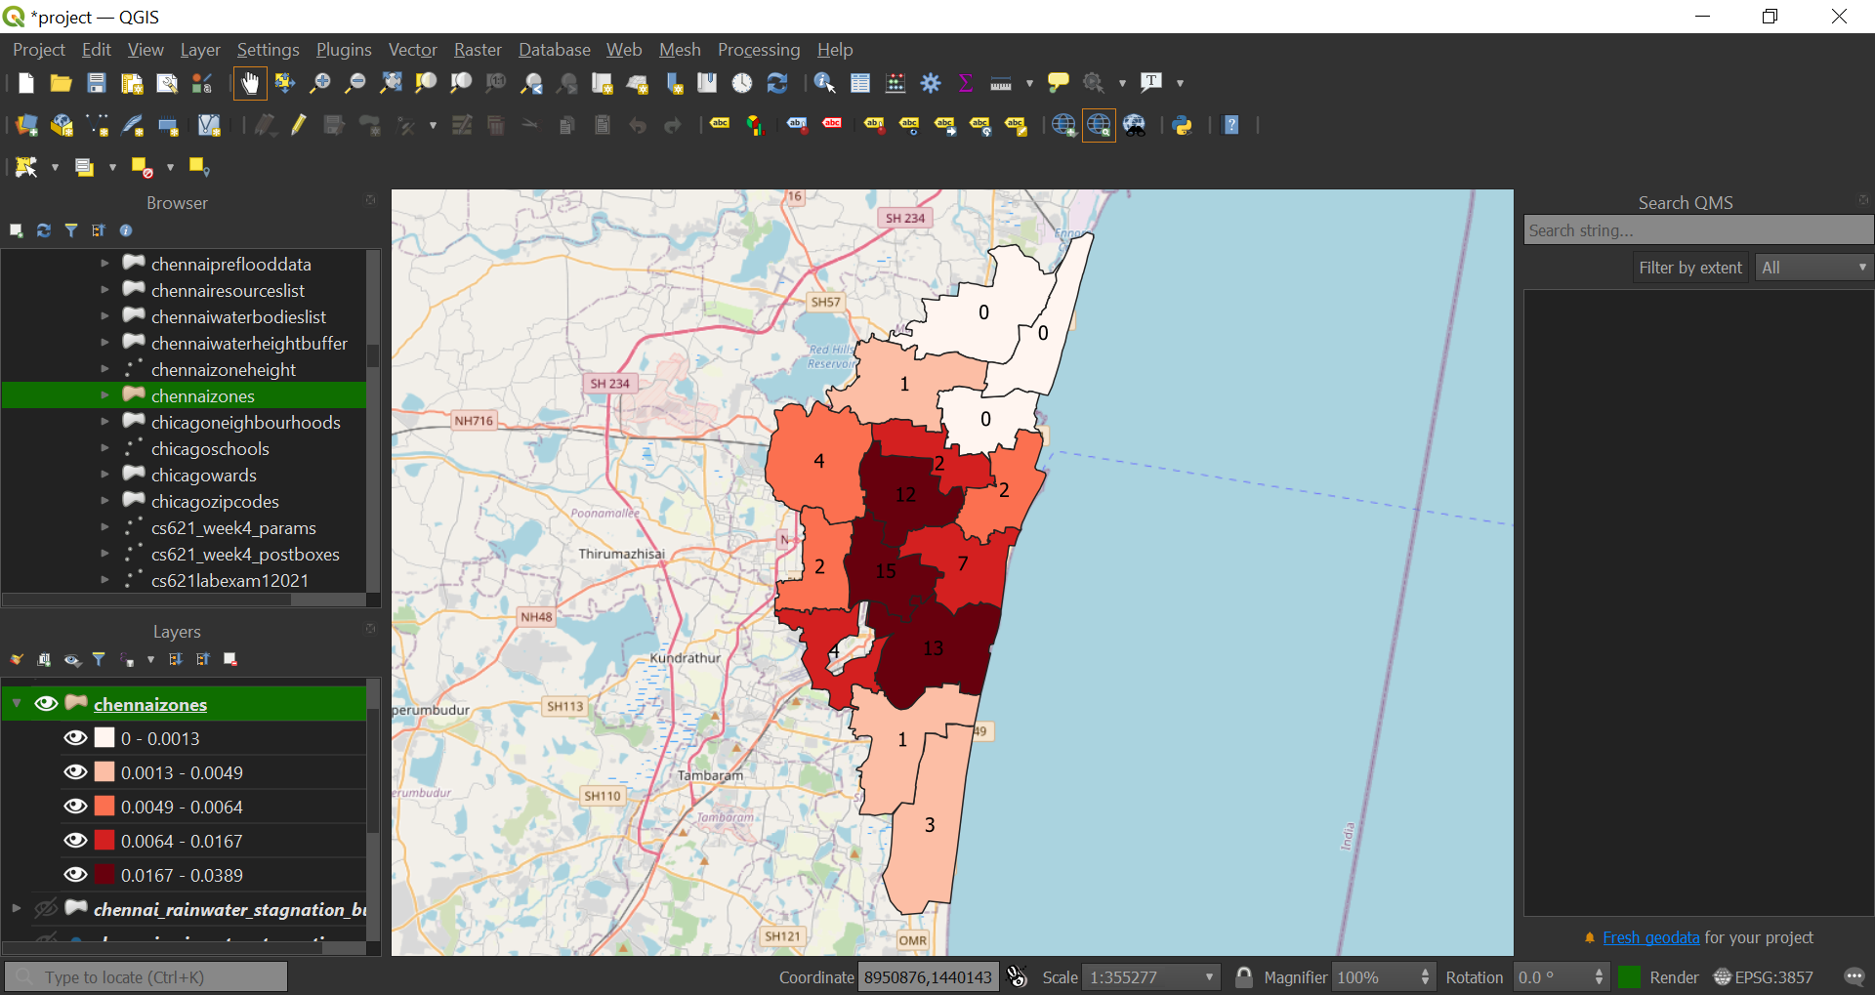
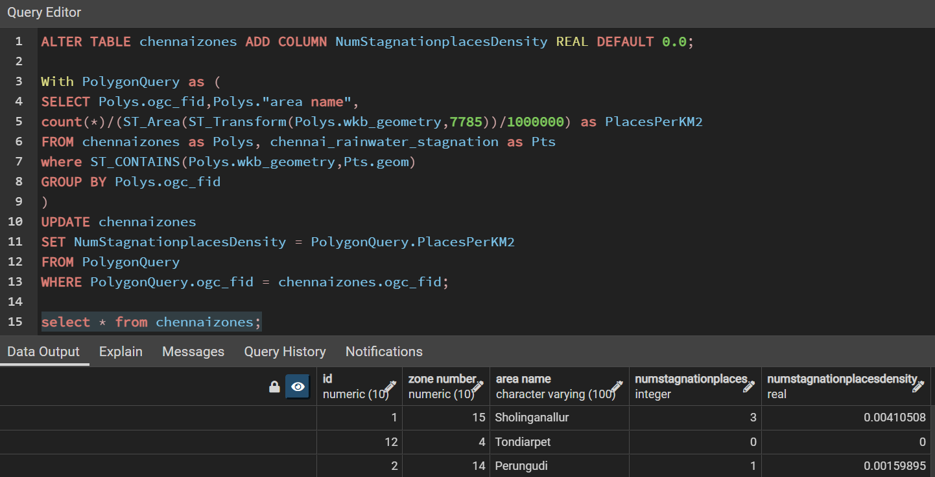
Analysis Choropleth mapping of the total density of Rainwater stagnation areas

Slide 14
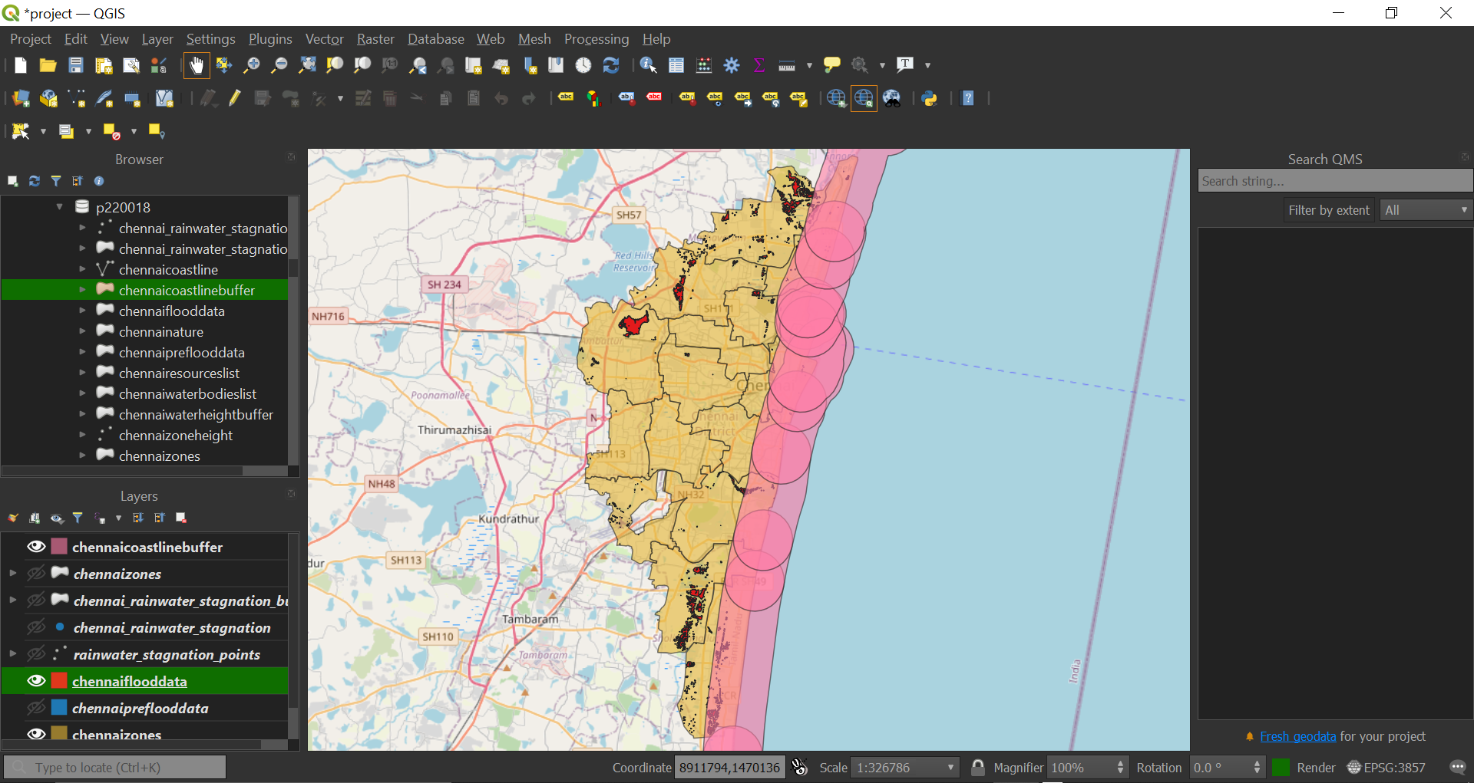
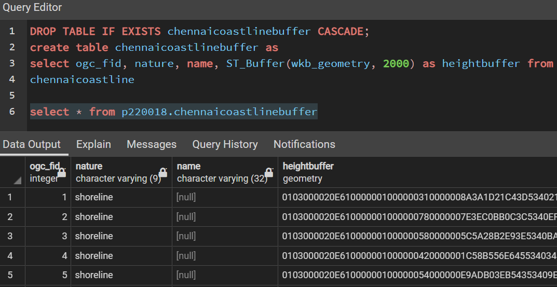
Analysis Buffer for the coastline around 2km

Slide 15
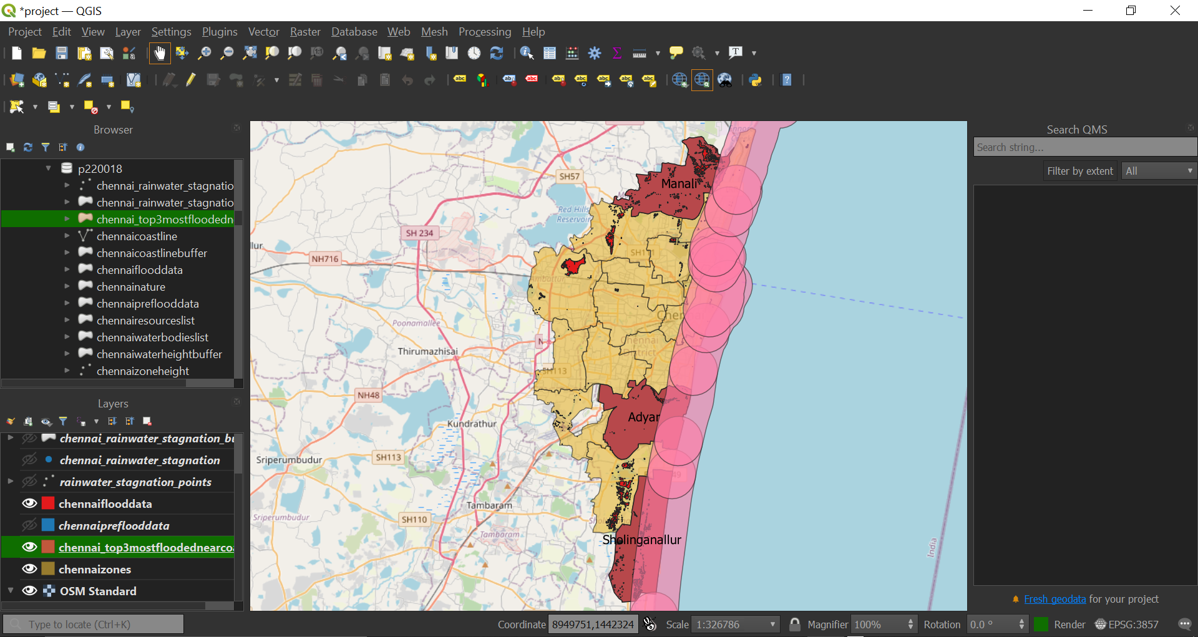
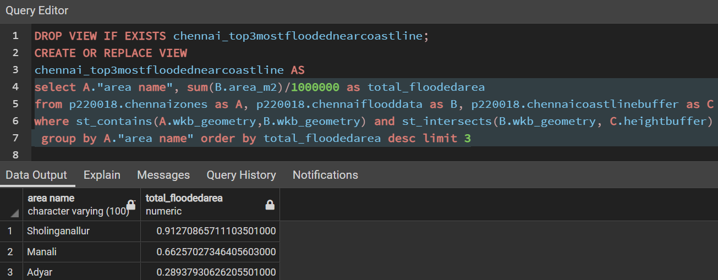
Analysis Top three zones to be avoided near the coastline

Slide 16
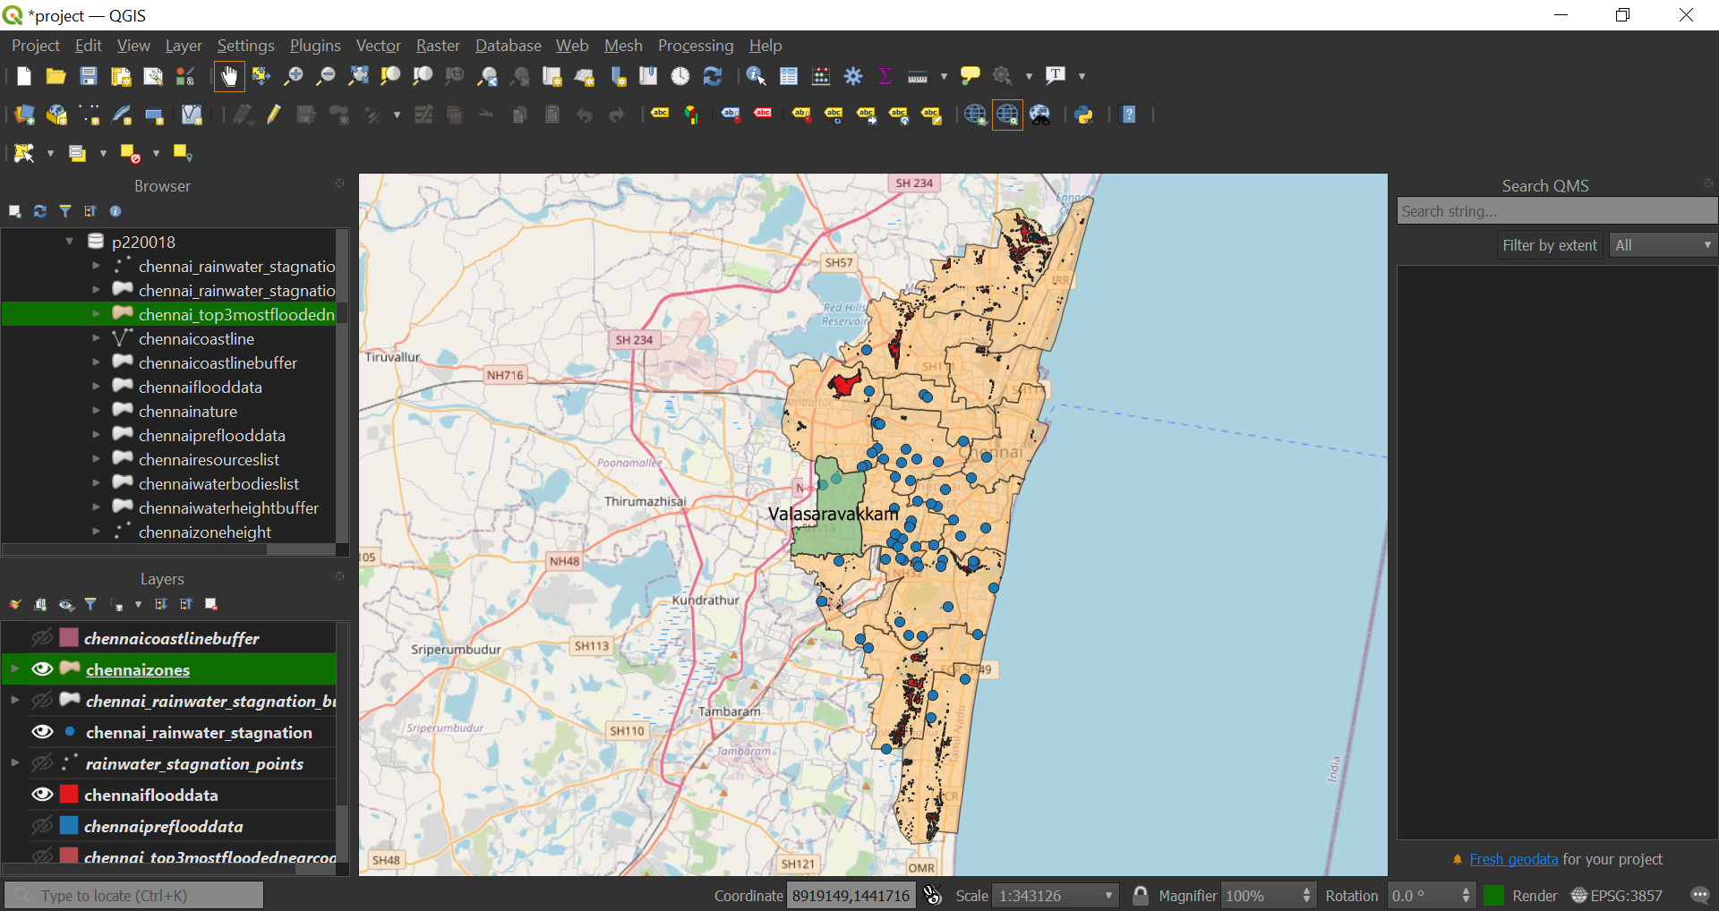
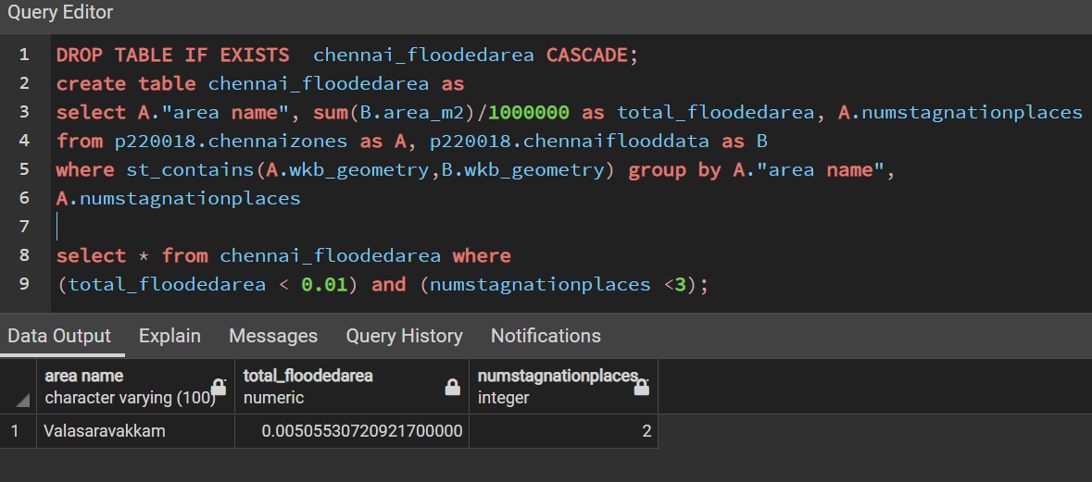
Analysis Safer zone Analyzing the flooded area and stagnation places

Slide 17
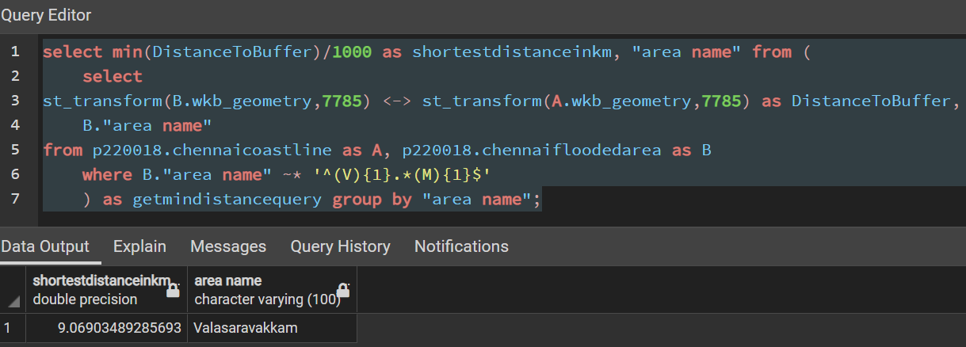
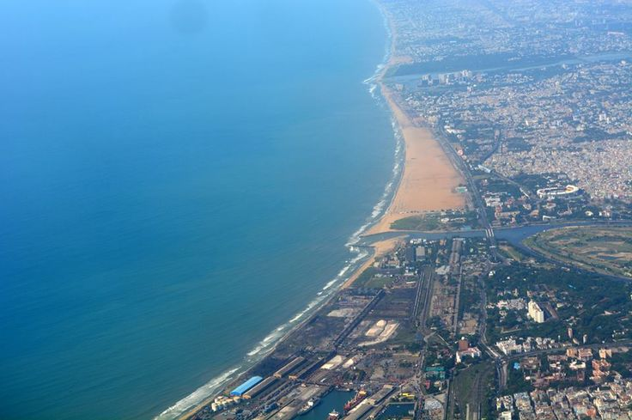
Analysis The distance to the coastline from safer zone

Slide 18

Thank you!
Project hosted @ https://github.com/nareshkumarnagaraj/cs621-spatial-db

